Slide 1
Scala
https://github.com/dchrusciak/scala-training

Slide 2
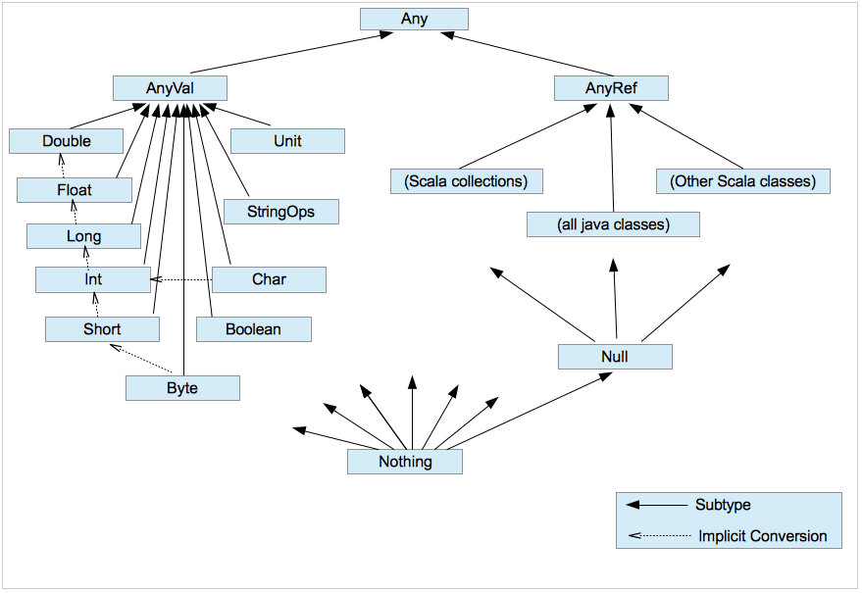
Data types

Slide 3
Recursion
factorial(5)
5 * factorial(4)
5 * 4 * factorial(3)
5 * 4 * 3 * factorial(2)
5 * 4 * 3 * 2 * factorial(1)
5 * 4 * 3 * 2 * 1
5 * 4 * 3 * 2
5 * 4 * 6
5 * 24
120

Slide 4
Tail recursion
factorial(5, 1)
factorial(4, 5)
factorial(3, 20)
factorial(2, 60)
factorial(1, 120)
120
120
120
120
120

Slide 5
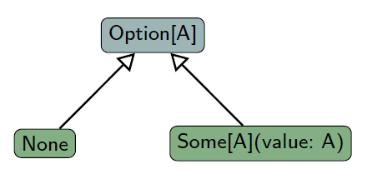
Option

Slide 6
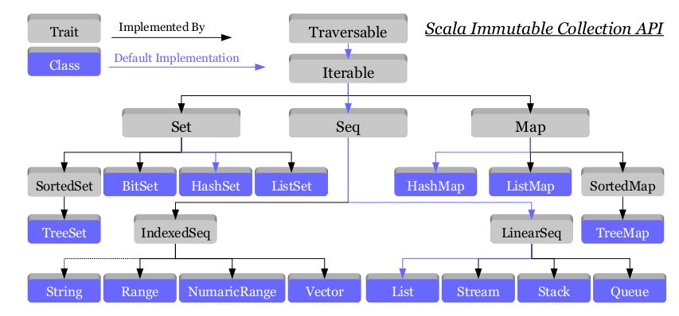
Immutable Collections

Slide 7
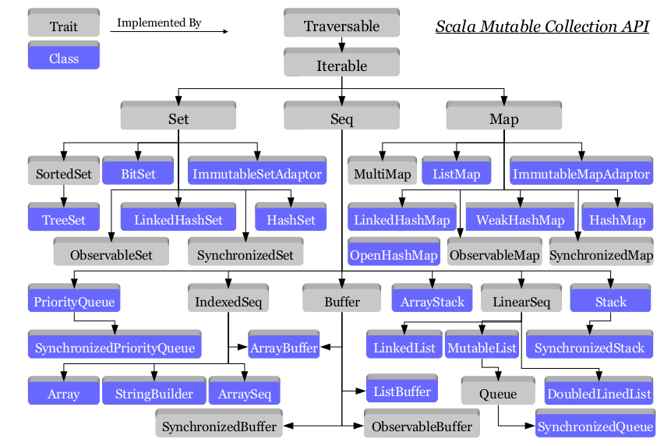
Mutable Collections

Slide 8
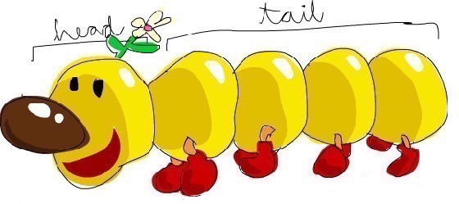
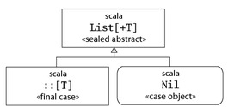
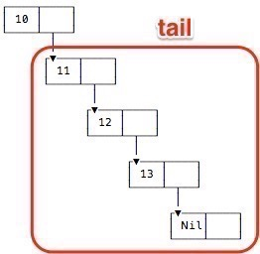
List

